Slide 1
Chapter 10 equilibrium
Wilt Gu

Slide 2
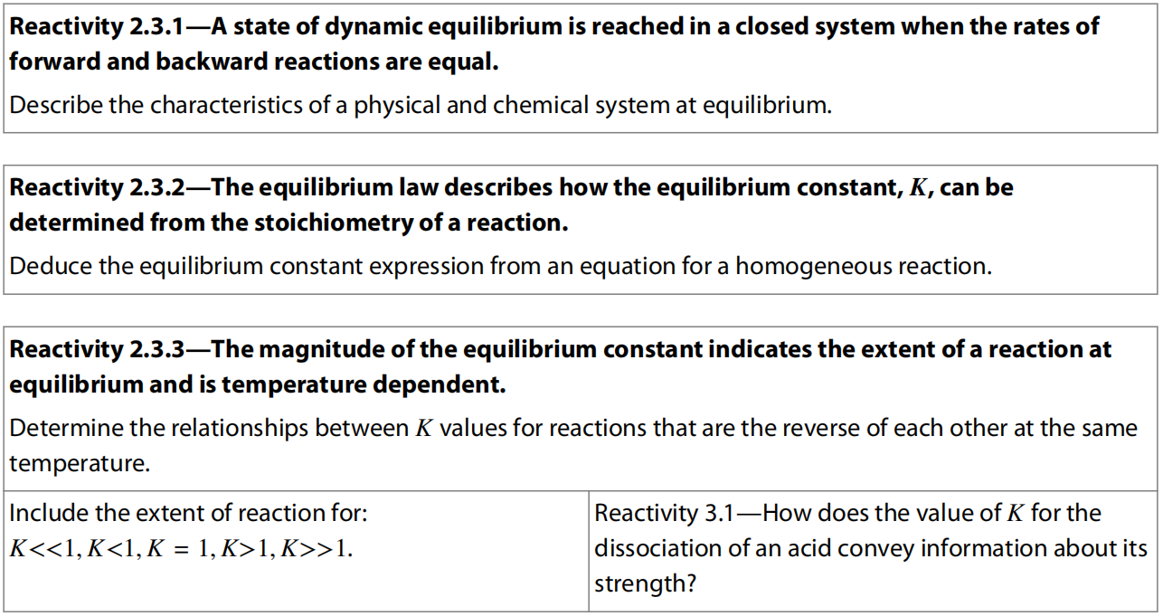
10.1 The Equilibrium

Slide 3
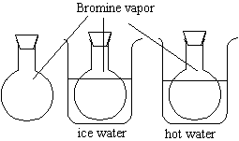
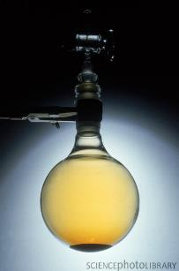
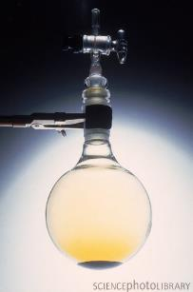
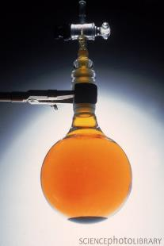
Reversible physical change
Phase transition equation at equilibrium:
evaporation
Br₂ (l) Br₂ (g)
condensation
Room T
Low T
High T

Slide 4
Reversible physical change

Slide 5
Reversible physical change
As bromine is a volatile liquid, with a boiling point close to room temperature, a significant number of particles (molecules of Br₂) will have enough energy to escape from the liquid state and form vapour in the process known as evaporation.
As the container is sealed, the bromine vapour cannot escape and so its concentration will increase.
Some of these vapour molecules will collide with the surface of the liquid, lose energy, and become liquid in the process known as condensation.

Slide 7
Reversible physical change
The rate of condensation increases with the increase in concentration of vapour, as more vapour particles collide with the surface of the liquid.
Eventually, the rate of condensation is equal to the rate of evaporation, and at this point there will be no net change in the amounts of liquid and gas present.
It is said that the system has reached equilibrium.
This will only occur in a closed system, where the Br₂ (g) cannot escape as vapour but may condense back into the liquid.

Slide 8
Irreversible & Reversible reaction
Irreversible reactions: Products are more energetically favorable, highly negative ΔH， low E_{a}, reactions go to completion.
H⁺ + OH⁻ H₂O
Reversible reactions: reactants and products have similar magnitude of enthalpy.
NH₃ (g) + HCl (g) NH₄Cl (s)

Slide 9
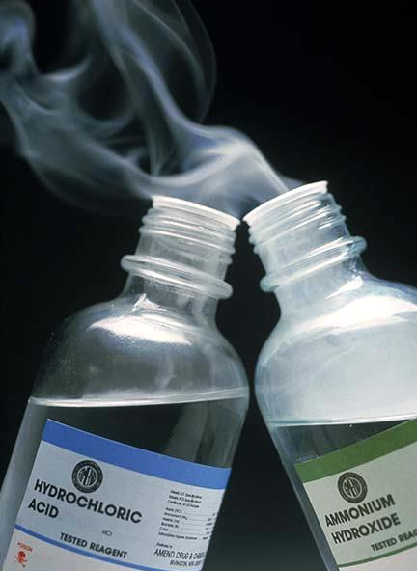
Reversible chemical reaction
NH₃ (g) + HCl (g) NH₄Cl (s)

Slide 10
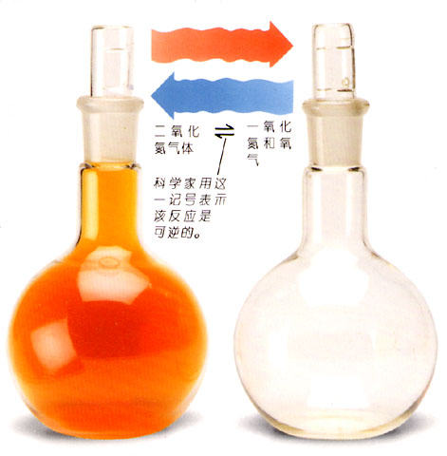
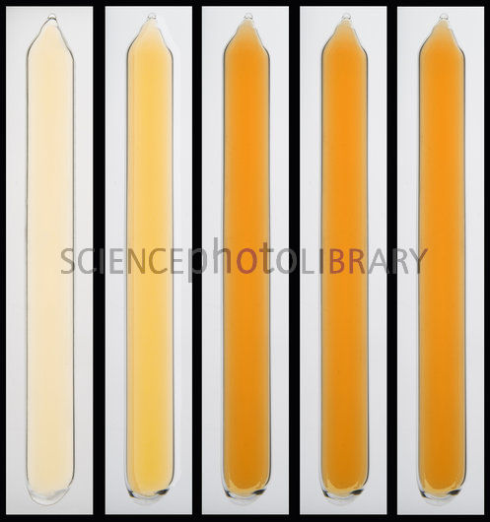
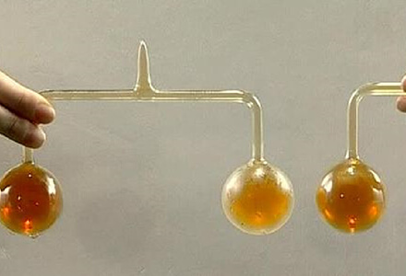
Reversible chemical reaction

Slide 11
Chemical equilibrium
Consider the reaction of dissociation between hydrogen iodide (HI) and its elements hydrogen (H₂) and iodine (I₂).
Hydrogen and hydrogen iodide are both colourless, whereas iodine is released as a purple gas, so this helps us to see what is happening.
If we carry out this reaction starting with hydrogen iodide in a sealed container, there will at first be an increase in the purple colour owing to the production of iodine gas.
But after a while this increase in colour will stop, and it may appear that the reaction too has stopped.

Slide 12
Chemical equilibrium
In fact, what has happened is that the rate of the dissociation of HI is fastest at the start when the concentration of HI is greatest and falls as the reaction proceeds.
Meanwhile, the reverse reaction, which initially has a zero rate because there is no H₂ and I₂ present, starts slowly and increases in rate as the concentrations of H₂ and I₂ increase.
Eventually, the rate of dissociation of HI has become equal to the rate of the reverse reaction of association between H₂ and I₂, so the concentrations remain constant.
At this point, equilibrium has been reached.
It is described as dynamic because both forward and backward reactions are still occurring at the same rate.
If we were to analyse the contents of the flask at this point, we would find that HI, H₂, and I₂ would all be present and that if there were no change in conditions, their concentrations would remain constant over time. We refer to this as the equilibrium mixture.

Slide 13
Chemical equilibrium
In studies of equilibria we are dealing with reversible reactions – those that occur in both directions.
The convention is to describe the reaction from left to right (reactants to products) as the forward reaction, and the reaction from right to left (products to reactants) as the backward reaction or reverse reaction.
The symbol is used to show that the reaction is an equilibrium reaction.

Slide 14
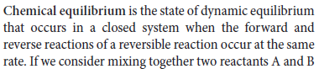
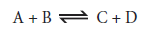
Chemical equilibrium

Slide 15
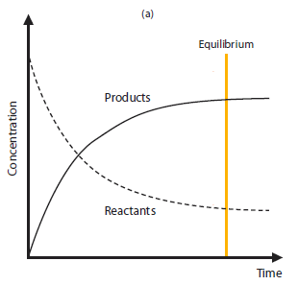
Chemical equilibrium

Slide 16
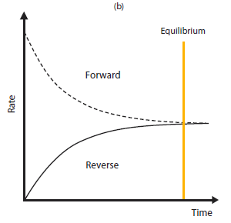
Chemical equilibrium

Slide 17
Chemical equilibrium
If we reversed the experiment and started with H₂ and I₂ instead of HI, we would find that eventually an equilibrium mixture would again be achieved in which the concentrations of H₂, I₂, and HI would remain constant.
And if the temperature, the volume of the container, the amount of H atoms and I atoms are all remained the same (i.e. 2mol HI, or 1mol H₂ and 1mol I₂, or 0.5mol HI, 0.75mol H₂ and 0.75mol I₂, and so on), the composition of the equilibrium mixture will also be identical as the previous situation.
This is known as equivalent equilibrium.

Slide 18
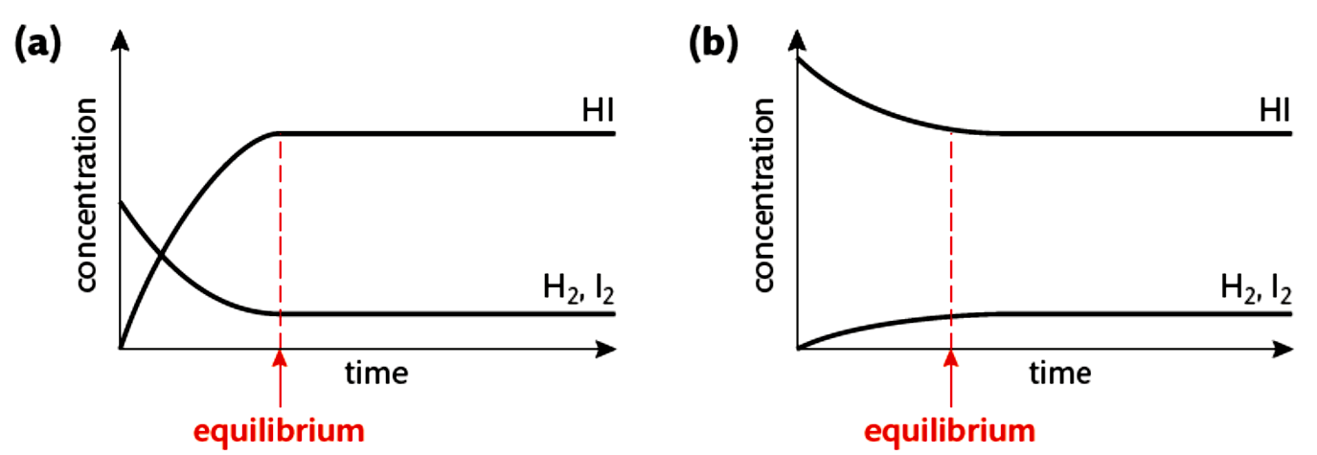
Chemical equilibrium

Slide 19
Chemical equilibrium
Be aware of the difference between rate of reaction and rate of consumption/production of reactants/rate of consumption/production of products.
In the previous example:
At equilibrium,
Rate of forward reaction
= Rate of reverse reaction
= Rate of consumption of H₂/I₂
= Rate of production of H₂/I₂
= 1/2 Rate of consumption of HI
= 1/2 Rate of production of HI
That is why we see different gradients for the rate curves.

Slide 20
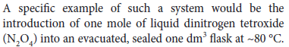
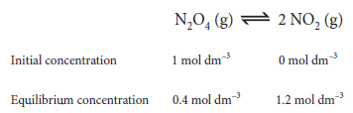
Chemical equilibrium

Slide 21
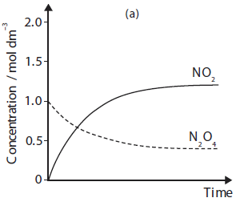
Chemical equilibrium

Slide 22
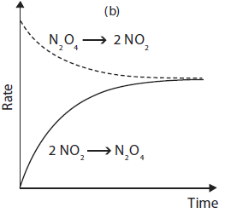
Chemical equilibrium

Slide 23
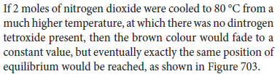
Chemical equilibrium

Slide 24
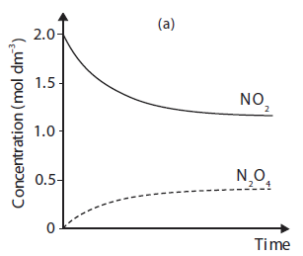
Chemical equilibrium

Slide 25
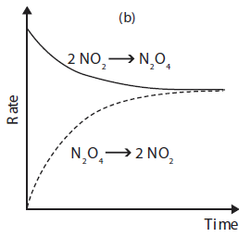
Chemical equilibrium

Slide 27
Chemical equilibrium
Make sure that you use the equilibrium symbol when writing equations for reactions where the reverse reactions are significant.
It is important to understand that even though the concentrations of reactant and product are constant at equilibrium, this in no way implies that they are equal.
In fact, most commonly there will be a much higher concentration of either reactant or product in the equilibrium mixture, depending both on the reaction and on the conditions.
What equal to each other at equilibrium are the rate of forward reaction and the rate of backward reaction.
The proportion of reactant and product in the equilibrium mixture is referred to as its equilibrium position.

Slide 28
Equilibrium constant
Consider now the reaction
If we were to carry out a series of experiments on this reaction with different starting concentrations of H₂, I₂, and HI, we could wait until each reaction reached equilibrium and then measure the composition of each equilibrium mixture.
Here are some typical results obtained at 440°C.

Slide 29
Equilibrium constant
0.0015

Slide 30
Equilibrium constant

Slide 31
Equilibrium constant
Clearly this way of processing the equilibrium data produces a constant value within the limits of experimental accuracy.
This constant is known as the equilibrium constant, K_{c}. It has a fixed value for this reaction at a specified temperature.
In fact, every reaction has its own particular value of K_{c} which can be derived in a similar way. First we use the balanced reaction equation to write the equilibrium constant expression.

Slide 32
Equilibrium constant

Slide 33
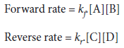
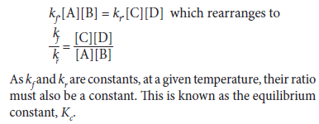
Equilibrium constant

Slide 34
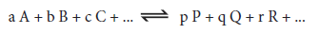
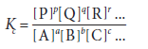
Equilibrium constant
For general reaction:
Unit of K_{c} is dependent on the expression of K_{c}

Slide 35
Equilibrium constant
Practice:
(aq)

Slide 36
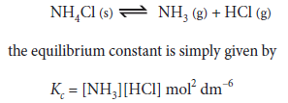
Equilibria involving more than one phase
All solids are not well distributed in the system, so these are omitted/included in the value of K_{c} --- not showing in the expression.

Slide 37
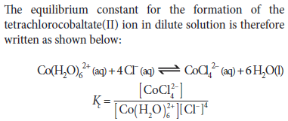
Equilibria involving more than one phase
The concentration of any pure liquid is also constant if it has a fixed density: like [H₂O] in dilute aqueous solutions.

Slide 38
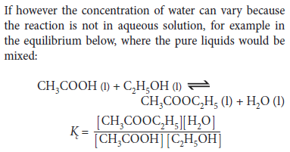
Equilibria involving more than one phase

Slide 39
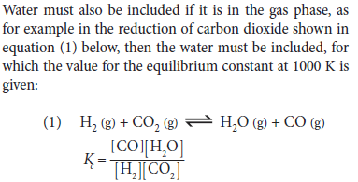
Equilibria involving more than one phase

Slide 40
Equilibria involving more than one phase
Summary:
All the species present in the K_{c} expression need to be of the same state.
If there are substances of more than 1 state in the reversible equation, then we follow this rule:
aq > g > l > s
This means if there is any one species in aq, then all the species in the K_{c} expression need to be in aq; if there is no species in aq, then we look for species in g, and so on.

Slide 41
Magnetude of Equilibrium constant

Slide 42
Magnetude of Equilibrium constant
K_{c} = 1 equilibrium lies roughly in the middle
K_{c} >> 1 equilibrium lies on the right hand side; if K_{c} is very large, reaction may be considered to go to completion
K_{c} << 1 equilibrium lies on the left hand side; if K_{c} is very small, reaction may be considered not to occur

Slide 43
Magnetude of Equilibrium constant

Slide 44
Equilibrium constant calculation
A + B C + D K_{c1}
C + D A + B K_{c2}
Reaction 2 = -- Reaction 1
K_{c2} = 1 / K_{c1}

Slide 45
Equilibrium constant calculation
A + B C + X K₁
B + X D K₂
A + 2B C + D K₃
Reaction 3 = Reaction 1 + Reaction 2
K₃ = K₁ · K₂

Slide 46
Equilibrium constant calculation

Slide 47
Equilibrium constant calculation
Example:

Slide 48
Equilibrium constant calculation

Slide 49
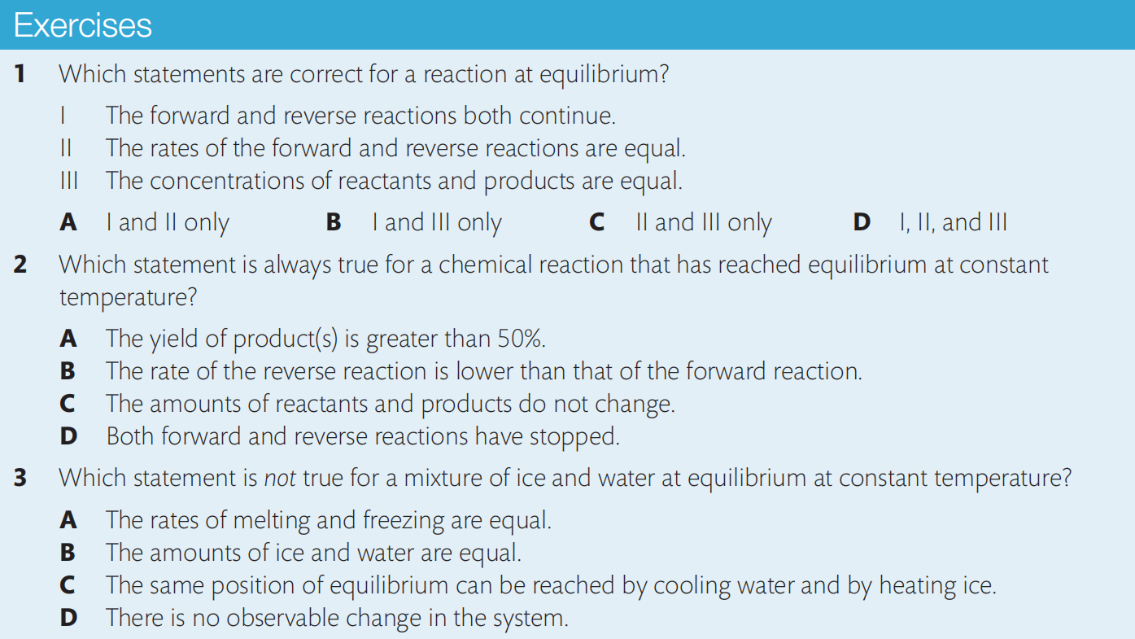
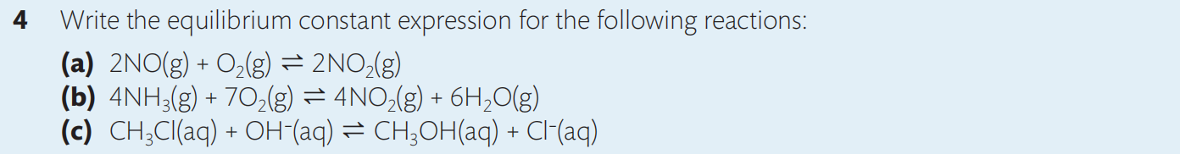

Slide 50
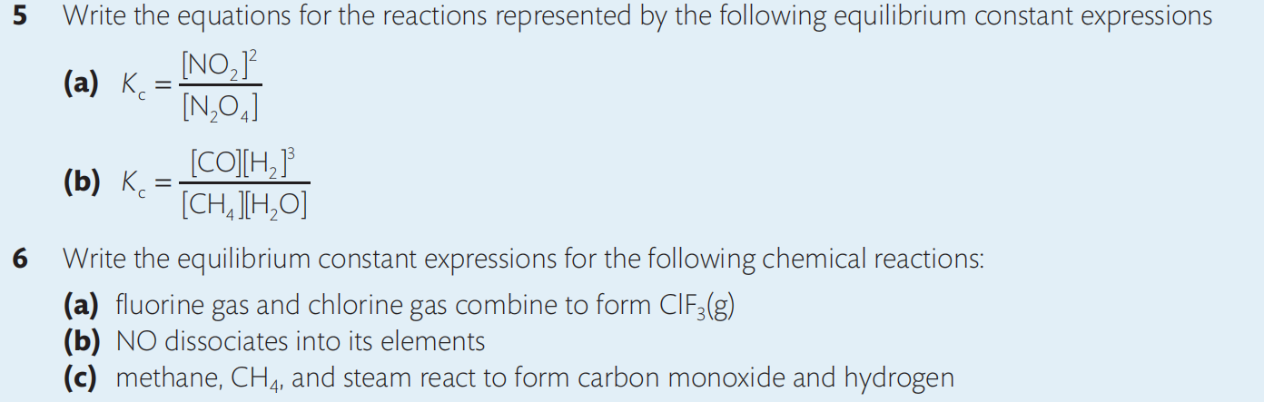
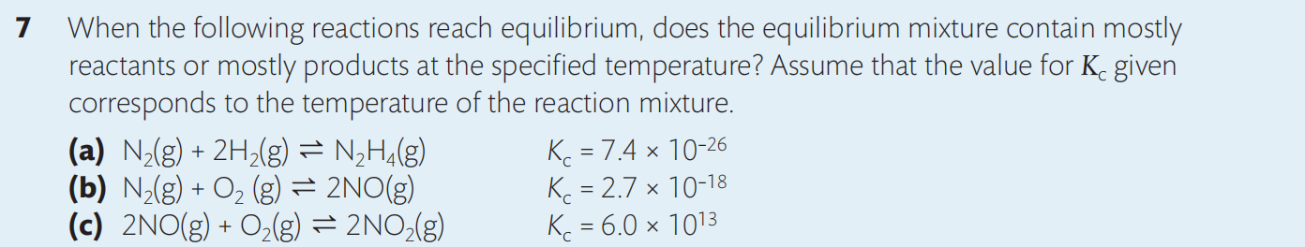
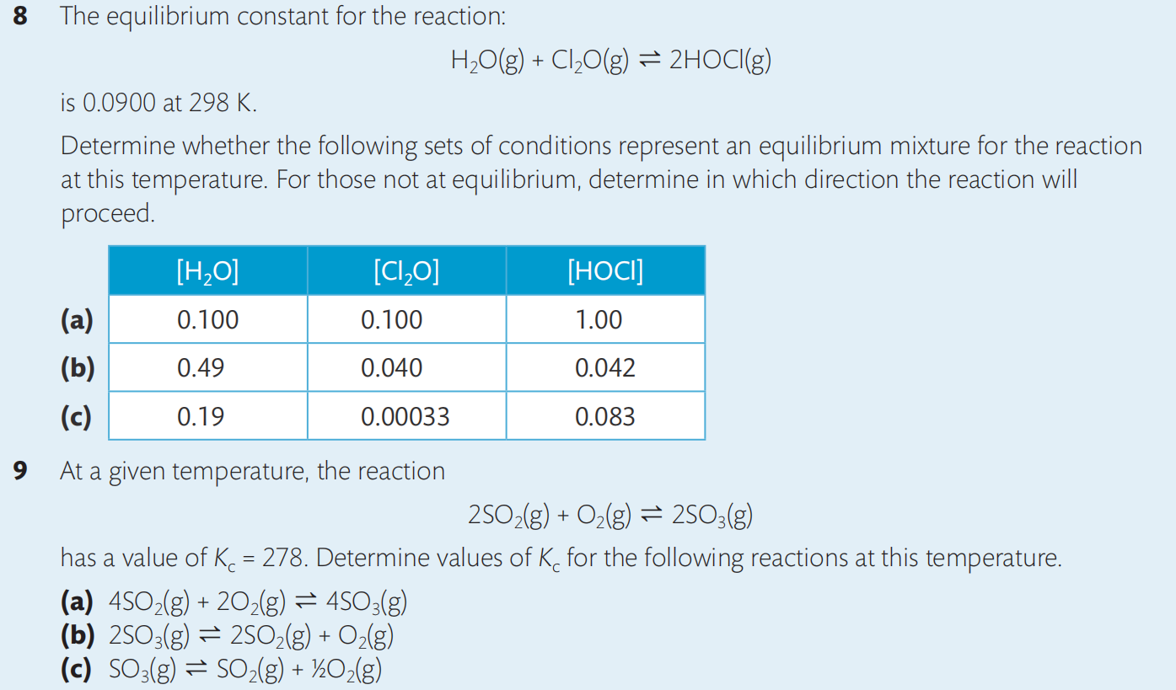

Slide 51
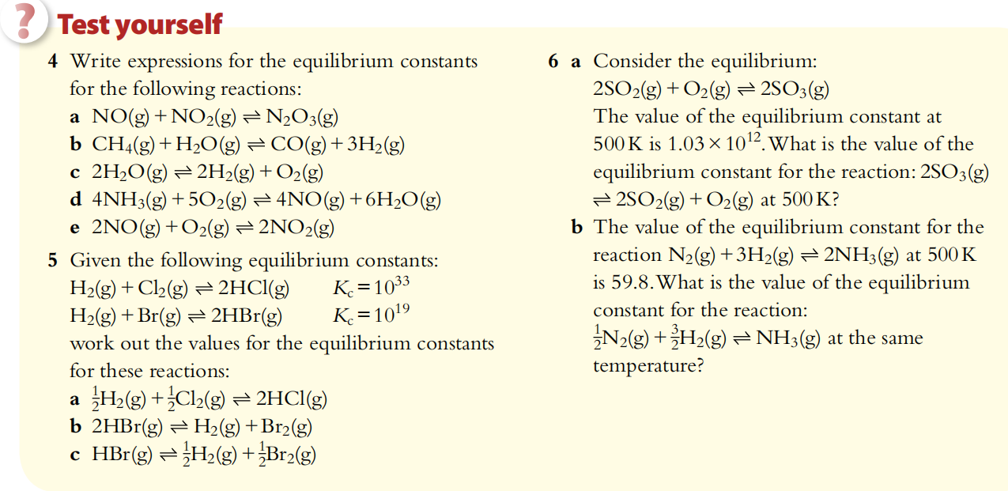

Slide 52
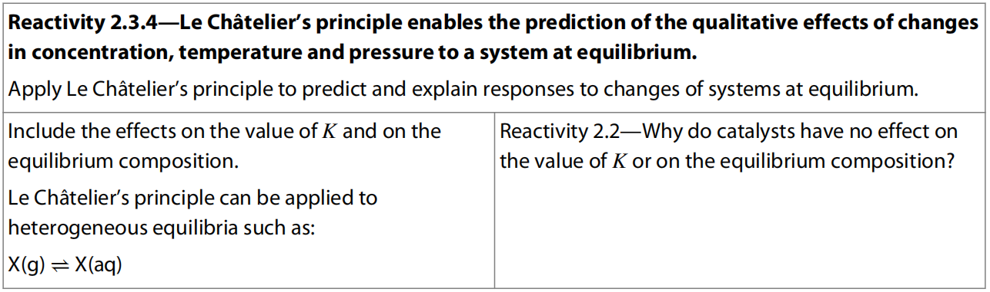
10.2 Le Chartelier’s Principle

Slide 53
Disturbing Equilibrium
Equilibrium will be disturbed if the conditions (Temperature, pressure, concentration, etc.) under which the equilibrium is established are changed.
The concentration of the species will change until the rates once again become equal and equilibrium is once more established.

Slide 54
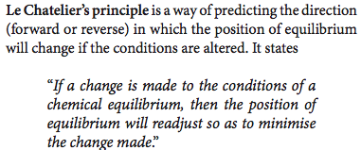
In other words:
If a chemical system at equilibrium experiences a change in concentration, temperature, volume, pressure, etc., then the equilibrium position shifts to reduce the imposed change and a new equilibrium is established.

Slide 55
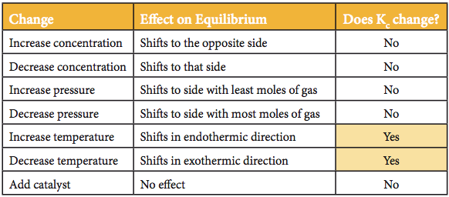

Slide 56
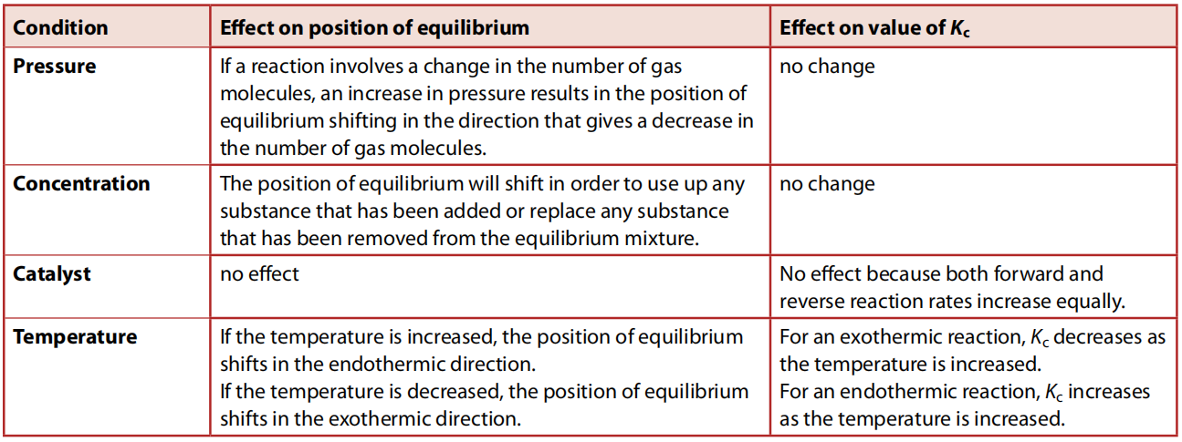

Slide 57
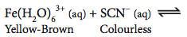
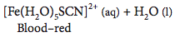
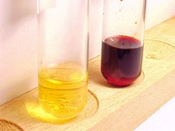
Effect of Concentration
Effect on equilibrium ?
Increase [SCN⁻]:
Decrease [SCN⁻]:

Slide 58
Effect of Concentration

Slide 59
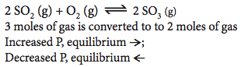
Effect of pressure
Effect on equilibrium?
Increase total pressure:
Decrease total pressure:

Slide 60
Effect of pressure

Slide 61
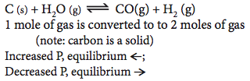
Effect of pressure
Effect on equilibrium?
Increase total pressure:
Decrease total pressure:

Slide 62
Effect of pressure

Slide 63
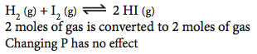
Effect of pressure
?

Slide 64
Effect of pressure

Slide 65
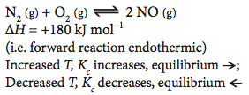
Effect of temperature
Effect on equilibrium ?
Increase T:
Decrease T:

Slide 66
Effect of temperature

Slide 67
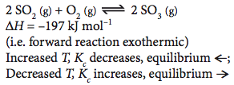
Effect of temperature
Effect on equilibrium ?
Increase T:
Decrease T:

Slide 68
Effect of temperature

Slide 69
Kinetics and equilibrium (HL Only)

Slide 70
Kinetics and equilibrium (HL Only)
In other words, the equilibrium constant is the ratio of the rate constants of the forward and backward reactions. This equation provides a fundamental link between chemical equilibrium and chemical kinetics.
We can finish this study by using the relationship between equilibrium constant and rate constants for a reaction to add to our interpretation of how equilibrium responds to changing conditions.

Slide 71
Kinetics and equilibrium (HL ONLY)

Slide 72
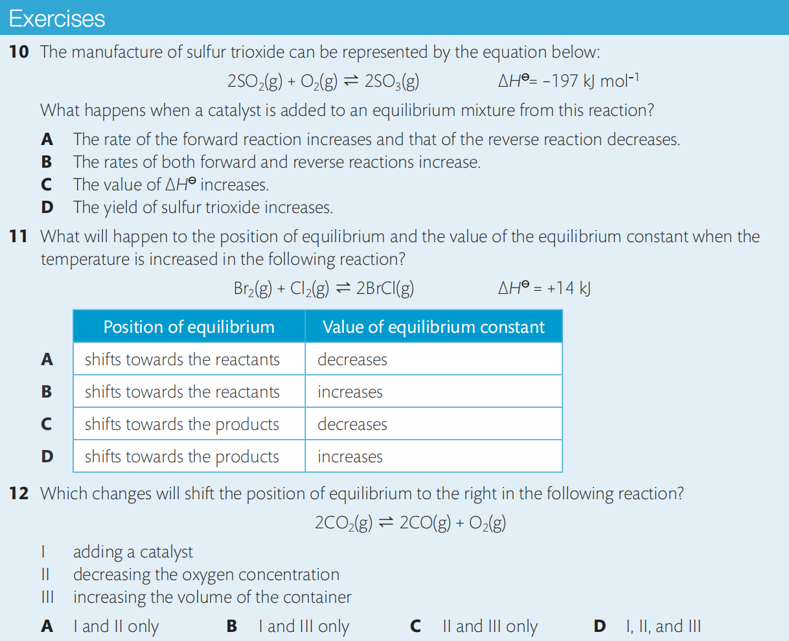

Slide 73
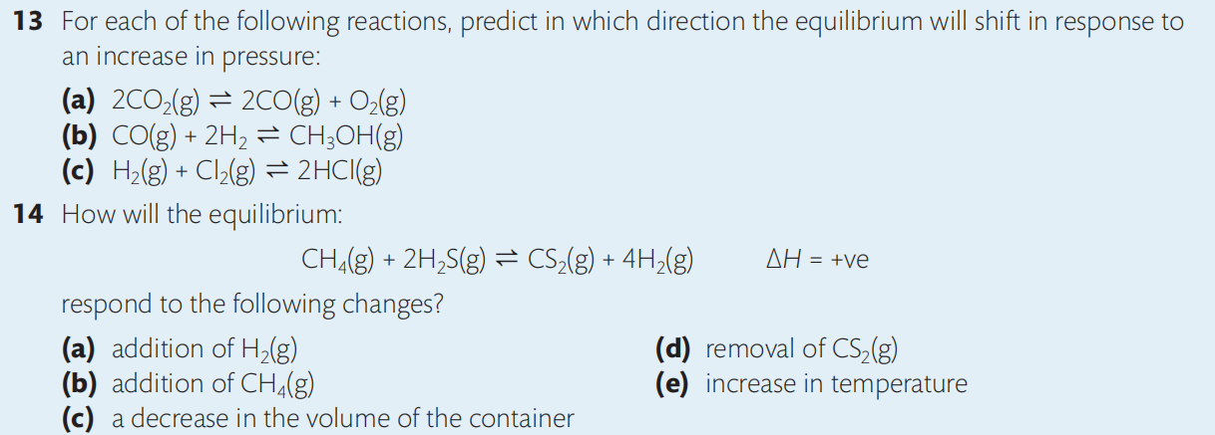
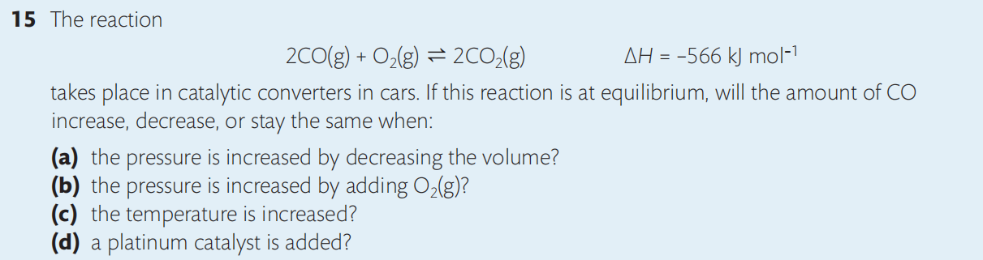

Slide 74



Slide 75
Industrial Proccesses (Not required) (Application of Le Chatelier’s Principle)
Fast reaction rate
High yield of product
Minimum amount of waste
Minimum input of energy
Consider both kinetics and equilibrium~

Slide 76


Haber process
△
Fe
Major use of ammonia:
manufacture of fertilizers, polymers (nylon), nitric acid, explosives
Fritz Haber
1918 Noble Price
How to produce ammonia efficiently?

Slide 77

Improving the yield of ammonia in the Haber process
Effect of pressure
On the left hand side there are 4 moles of gas, whilst on the right hand side there are 2 moles
Any increase in pressure will favour the forward reaction to produce more ammonia.
This is because the forward reaction will tend to decrease the pressure in the system.

Slide 78
Improving the yield of ammonia in the Haber process
In the Haber process the pressure is set as high as possible to give the best % yield.
High pressure containers are VERY expensive.
It could be possible to carry out the reaction at 1000 atmospheres – but this would not be economical (it would cost more than the product is worth).
The typical pressure used is 200 to 350 atmospheres.

Slide 79
Improving the yield of ammonia in the Haber process
The reaction produces heat when it moves to the right.
This means that a LOWER temperature would favour the forward reaction, BUT….
Reactions go slower at lower temperatures!
In operating the Haber process you have to decide what is more important, the higher YIELD you can get at lower temperatures or the higher RATE at higher temperatures.

Slide 80


Slide 81
Improving the yield of ammonia in the Haber process
In order to get ammonia produced at a quicker RATE the reaction is carried out at a high temperature (450ºC).
It is better to get just a 10% yield in 20 seconds (at a high temperature) that a 20% in 60 seconds (at a lower temperature)

Slide 82


Compromised conditions

Slide 83

It took over 6500 experiments at different temperatures and pressures carried out by the German Carl Bosch to work all this lot out.
He got a Nobel Prize for it in 1931!
(Haber got his Nobel Prize in 1918)

Slide 84

Other ways of increasing the yield in the Haber process
An IRON catalyst makes the reaction occur more quickly, (it does not affect the % yield i.e. the position of the dynamic equilibrium).
Without the catalyst the temperature would have to be much higher (this would lower the yield).

Slide 85
Other ways of increasing the yield in the Haber process
Removing the ammonia from the system also pushes the reaction to the right so more ammonia is produced to replace it.

Slide 86
Contact process
H₂SO₄
commercially important raw material
more sulfuric acid made than any other compound
fertilisers, paints and pigments, detergents,
car batteries, laboratory acid

Slide 87
Contact process
H₂SO₄
H₂O
Air
Sulfur
manufacture
properties
uses

Slide 88
Contact process
H₂SO₄
H₂O
Air
Sulfur
manufacture
Step 1: Formation of SO₂
either S + O₂ SO₂
or 4 FeS₂ + 11 O₂ 8 SO₂ + 2 Fe₂O₃

Slide 89
Contact process
H₂SO₄
H₂O
Air
Sulfur
manufacture
Step 2: Formation of SO₃ the Contact Process
2 SO₂ + O₂ 2 SO₃ exothermic

Slide 90
Contact process
H₂SO₄
H₂O
Air
Sulfur
manufacture
Step 3: Formation of Oleum
SO₃ + H₂SO₄ H₂S₂O₇
{the direct combination of SO₃ with water is too exothermic and forms a fine mist of acid}

Slide 91
Contact process
H₂SO₄
H₂O
Air
Sulfur
manufacture
Step 4: Dilution of Oleum
H₂O + H₂S₂O₇ 2 H₂SO₄
the oleum is diluted to give the desired concentration
of sulphuric acid

Slide 92
Contact process
H₂SO₄
H₂O
Air
Sulfur
manufacture
Step 2: Formation of SO₃ the Contact Process
2SO₂ + O₂ 2SO₃ exothermic
Let’s look at this equilibrium more closely….

Slide 93
Contact process
Step 2: Formation of SO₃ the Contact Process
2 SO₂ + O₂ 2 SO₃ exothermic
Factors:
Catalyst
Temperature
Pressure

Slide 94
Contact process
Step 2: Formation of SO₃ the Contact Process
2 SO₂ + O₂ 2 SO₃ exothermic
Factors:
Catalyst V₂O₅
Temperature
Pressure

Slide 95
Contact process
Step 2: Formation of SO₃ the Contact Process
2 SO₂ + O₂ 2 SO₃ exothermic
Factors:
Catalyst V₂O₅
Temperature 450ºC
Pressure

Slide 96
Contact process
Step 2: Formation of SO₃ the Contact Process
2 SO₂ + O₂ 2 SO₃ exothermic
Factors:
Catalyst V₂O₅
Temperature 450ºC
Pressure 1-2 atmospheres
***These are compromise conditions***

Slide 97
Contact process
Step 2: Formation of SO₃ the Contact Process
2 SO₂ + O₂ 2 SO₃ exothermic
Factors:
Catalyst V₂O₅
The catalyst works best as the temperature increases
Provides an alternative path with a lower E_{act}
Speeds up time taken to achieve equilibrium
Several catalyst beds used to achieve high yield
***These are compromise conditions***

Slide 98
Contact process
Step 2: Formation of SO₃ the Contact Process
2 SO₂ + O₂ 2 SO₃ exothermic
Factors:
Temperature 450ºC
The yield of SO₃ increases as T is decreased
However
Catalyst does not work if T is too low
Rate of attainment of equilibrium is slow if T is too low
***These are compromise conditions***

Slide 99
Contact process
Step 2: Formation of SO₃ the Contact Process
2 SO₂ + O₂ 2 SO₃ exothermic
Factors:
Pressure 1-2 atmospheres
The yield of SO₃ increases as P is increased
High pressure is costly
***These are compromise conditions***

Slide 100
Contact process
H₂SO₄
manufacture
properties
Viscous liquid
Dehydrating
agent

Slide 101
Contact process
H₂SO₄
manufacture
properties
uses
Viscous liquid
Dehydrating
agent
Conc H₂SO₄ will dehydrate hydrated copper sulphate
and carbohydrates

Slide 102
Production of methanol
Again, Le Chatelier’s principle can be used to consider the conditions that will optimize the production.

Slide 103


Slide 104

10.3 Reaction Quotient and Equilibrium Law (Higher Level)

Slide 105
The reaction quotient
Remember that the value of K_{c} is calculated from substituting the equilibrium concentrations of all reactants and products into the equilibrium constant expression.
Any other values used will not give the equilibrium value K_{c} for that reaction at that temperature.
If we take the concentrations of the reactants and products at one moment in time when the reaction is not at equilibrium, and substitute these into the equilibrium constant expression, we obtain a value known as the reaction quotient, Q.
As time passes and the reaction continues, the concentrations of all reaction components change and eventually reach the equilibrium concentrations.
In other words, the value of Q changes in the direction of K_{c}. This enables us to predict the direction in which the reaction will proceed.

Slide 106
The reaction quotient

Slide 107
The reaction quotient

Slide 108
The reaction quotient
The reaction quotient, Q, is a measure of the relative amounts of reactants and products present in a reaction at a particular time.
Its value is determined from substituting concentrations of reaction components, all measured at the same time and under the same temperature, into the equilibrium expression.
If Q = K_{c}, reaction is at equilibrium, no net reaction occurs.
If Q < K_{c}, reaction proceeds to the right in favor of products.
If Q > K_{c}, reaction proceeds to the left in favor of reactants.

Slide 109
The reaction quotient
Example:

Slide 110
The reaction quotient

Slide 111
calculation of the equilibrium constant
If we know the equilibrium concentrations of all reactants and products in a reaction, we can simply substitute these into the equilibrium expression to calculate K_{c}.
The first step in such a calculation is always to write the equilibrium expression from the chemical equation.

Slide 112
calculation of the equilibrium constant
Practice:

Slide 113
calculation of the equilibrium constant

Slide 114
calculation of the equilibrium constant
More commonly, we may first have to work out the value for the equilibrium concentration for one or more reactants or products from data on initial concentrations and equilibrium concentrations of other components.
The important thing here is to be sure that only equilibrium concentrations are substituted into the equilibrium expression.
The steps given below will help you to do this. These steps will be a useful guide through many calculations in this chapter and the work on acids and bases that follows.

Slide 115
calculation of the equilibrium constant
1. Write the balanced equation.
2. Under the equation, write in the values of the concentrations of each component using three rows: initial, change, and equilibrium.
Initial represents the concentration originally placed in the flask; unless stated otherwise, we assume the initial product concentration is zero.
Change represents the amount that reacts to reach equilibrium. A minus sign for reactants represents a decrease in concentration as they are used up, and a plus sign for products represents an increase in concentration as they form.
The changes that occur must be in the same ratio as the coefficients in the balanced equation, so if we know one of the change values we can deduce the others.
Equilibrium is the concentration present in the equilibrium mixture. This can be calculated by applying the amount of change to the initial concentration for each component.
equilibrium concentration = initial concentration ± change in concentration
3. Write the expression for Kc from the balanced equation. Substitute the values for equilibrium concentration and calculate K_{c}.

Slide 116
calculation of the equilibrium constant
Practice:

Slide 117
calculation of the equilibrium constant

Slide 118
calculation of the equilibrium constant
Practice:

Slide 119

calculation of the equilibrium constant

Slide 120
Calculating equilibrium concentrations
If we know the value of K_{c} and the equilibrium concentrations of all but one of the components, we can calculate the remaining equilibrium concentration simply by substituting the values into the equilibrium expression.

Slide 121
Calculating equilibrium concentrations
Practice:

Slide 122
Calculating equilibrium concentrations

Slide 123
Calculating equilibrium concentrations
Practice:

Slide 124
Calculating equilibrium concentrations

Slide 125
Calculating equilibrium concentrations

Slide 126
Calculating equilibrium concentrations
In some reactions the value of K_{c} is very small, less than 10^{–3}.
As we learned in section 7.1, this represents a reaction in which the forward reaction has hardly proceeded and the equilibrium mixture consists almost entirely of reactants.
In other words, the change in reactant concentrations is close to zero, as the equilibrium concentrations of reactants are approximately equal to their initial concentrations:
[reactant]_{initial} ≈ [reactant]_{equilibrium}
This situation is common in the study of weak acids and bases as they dissociate only slightly, and so this approximation will help you in these calculations in Chapter 8.

Slide 127
Calculating equilibrium concentrations
Practice:

Slide 128
Calculating equilibrium concentrations

Slide 129
Calculating equilibrium concentrations

Slide 131


Slide 132


Slide 133


Slide 134


10.4 Equilibrium & Gibbs Free Energy
(Higher Level)

Slide 135
ΔG & ΔGº
The standard free energy change ΔGº can be calculated for a reaction from the equation:
The Gº is the G that pure products or reactants contain, so the ΔGº is the free energy difference between pure products and pure reactants.
Remember that the Gibbs free energy change, ΔG, is a measure of the work that is available from a system.
Its sign is used to predict the spontaneity of a reaction.
ΔG = negative: reaction proceeds in the forward direction
ΔG = positive: reaction proceeds in the backward direction
ΔG = 0: reaction is at equilibrium
In this case, ΔG is the free energy difference between any two state during the reaction process.

Slide 136
Free energy and equilibrium
In a system that poccess a reverible reaction, the G minimum is always in between pure reactants and pure products since it need to be the most feasible considering both enthalpy and entropy and this is also the equilibrium state.
Therefore, ΔG between pure reactants and the equilibrium state is always negative, so is ΔG between pure products and the equilibrium state.
That explains why either pure reactants or pure products would react to reach the equilibrium with both reactants and products.

Slide 137
Free energy and equilibrium
ΔG

Slide 138
Free energy and equilibrium
ΔG

Slide 139
Free energy and equilibrium
Consider what happens to the total free energy during a reaction, such as when a fully charged battery is used until it is fully discharged (dead).
At the start of the reaction, the total free energy of the reactants is greater than that of the products so a lot of work is available. ΔG is negative and the reaction proceeds in the forward direction (theoretically even if there are only products, the reaction would still proceed in the backward direction but just with a small extent, since ΔG is always negative for pure reactants or pure products).
As the battery discharges, the reaction continues converting reactants to products. So the total free energy of the reactants decreases while the free energy of the system decreases. ΔG becomes less negative and less work is available.
The system reaches equilibrium when the total free energies of the system reach a minimum and no work can be extracted from the system. The battery is dead, but there are still some reactants present in the battery mixture.

Slide 140
Free energy and equilibrium
The total free energy of a system constantly decreases as the reaction progresses until it reaches equilibrium.
Starting with either pure reactants or pure products, the free energy decreases as the reaction moves towards equilibrium.
In (a) Gº _{reactants} > Gº _{products} so ΔGº is negative for the reaction. This means when the reaction occurs, it would proccess forward until the system reaches equilibrium, and the equilibrium mixture consists largely of products.
In (b) Gº _{reactants} < Gº _{products} so ΔGº is positive for the reaction. This means very little forward reaction would occur before equilibrium, and the equilibrium mixture consists largely of reactants.

Slide 141
Free energy and equilibrium
In summary, ΔGº can be used to predict the spontaneity of a reaction and the position of equilibrium as follows.
A reaction with a value of ΔGº that is both large and negative, appears to occur spontaneously and has an equilibrium mixture with a high proportion of products.
A reaction with a value of ΔGº that is large and positive, appears to be almost non-spontaneous as only minute amounts of product form. It has an equilibrium mixture that is predominantly reactants.

Slide 142
Free energy and equilibrium
We have now identified two terms which relate to the position of equilibrium:
K_{c}, the equilibrium constant;
ΔGº, the change in free energy.
Clearly these terms must be related to each other.
The equation which shows this relationship is derived from the principles of thermodynamics.
ΔGº = –RT lnK_{c}
This equation is given in section 1 of the IB data booklet. In this equation:
ΔGº = standard free energy change of the reaction
R = the gas constant 8.31 J K^{–1} mol^{–1}
T = the absolute temperature, in Kelvin
lnK_{c} = the natural logarithm of the equilibrium constant, K_{c}.
From this equation we can deduce relationships between ΔGº and K_{c} for a reaction.

Slide 143
Free energy and equilibrium
Practice:

Slide 144


Slide 145


